Slide 1
Data Engineering Medical Images for Improved Interoperability and Patient Security
Ian Hay
Professor John Rachlin
17th October 2022

Slide 2
What is a Blockchain?
Header: Previous block’s hash, block metadata
Message:
Transaction data
A distributed ledger of blocks connected by a chain of cryptographic hashes
Content of block n is dependent on content of block n-1
Hash of entire block’s content ensures tamper proofing
Cannot alter block content without changing the block’s hash
Cannot change the block’s hash without disrupting the chain
Diagram of a single block
Genesis Block
Hash₁
Hash₂
Hash₁
Hash₂
Hash₃
Diagram of a blockchain

Slide 3
Types of Blockchains
Permissioned
Nodes are not created equal
Allows for access control
Hyperledger Fabric most widely used permissioned blockchain
Open-source from the Linux Foundation
Used to form trusted, private networks
Permissionless
All nodes are created equal
Anyone can add to blocks
With a certain cost associated
Bitcoin, Ethereum are examples of permissionless blockchains
Used to form trustless, decentralized public networks

Slide 4
How did we transition from paper to electronic health records?
The 1996 Health Insurance Portability and Accountability Act (HIPAA) established modern security and privacy guidelines for personal health information
Healthcare organizations and businesses are only allowed to disclose personal health information to the patient and their authorized representatives
Requires privacy-preserving data storage and transfer via encryption and anonymization
The US Government, through Medicare and Medicaid financial incentives, subsidized the adoption of EHRs
Health Information Technology for Economic and Clinical Health (HITECH) Act of 2009
Paid out $13 Billion from 2009-2013
Prioritized EHR adoption over interoperability
Extended security and privacy requirements for businesses associated with medical data
Implemented fines and legal consequences for non-compliance

Slide 5
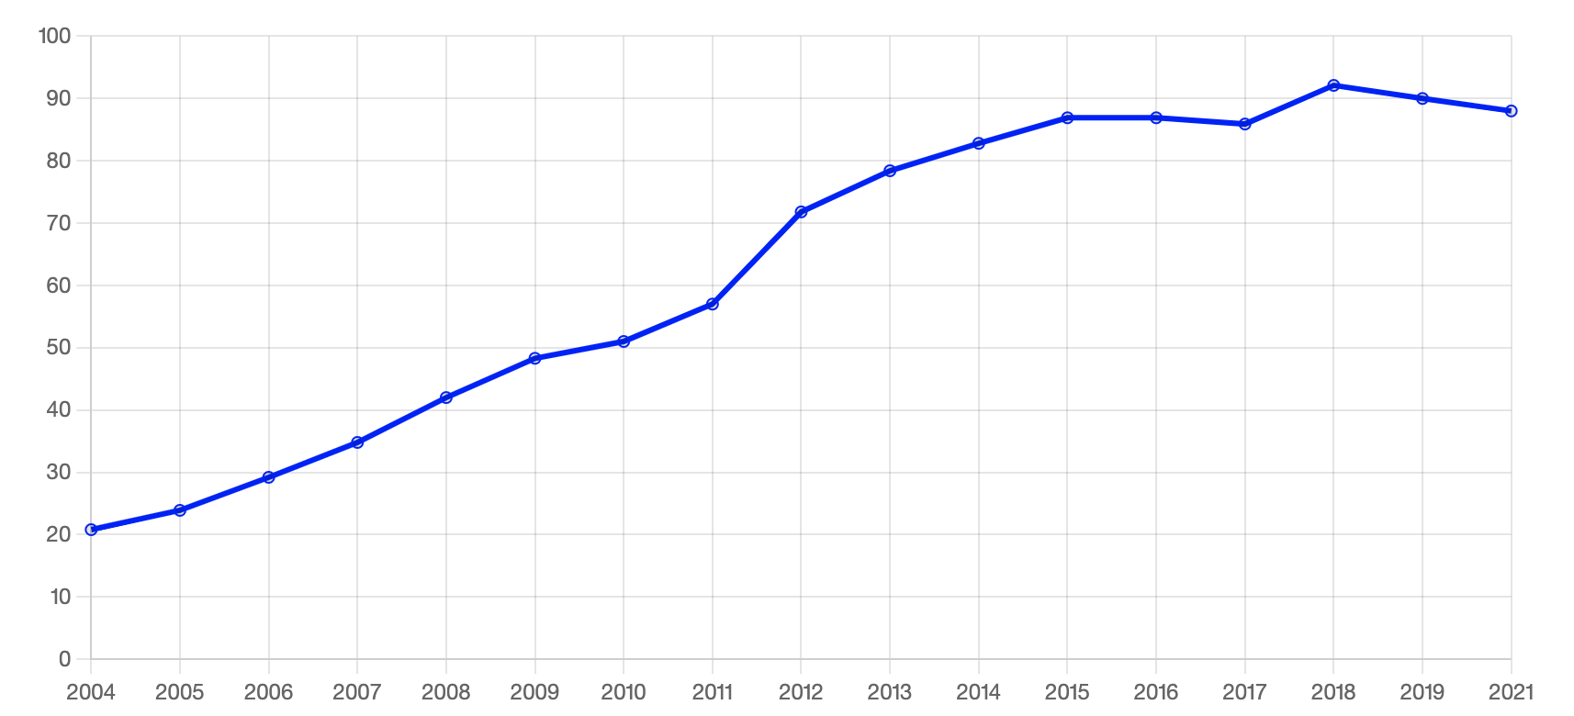
Current State of EHRs (in the US)
Hospital systems adopted proprietary data storage and management systems to preserve patient privacy and security
Medical data is among the most complex and challenging to standardize
Health Level 7 (HL7) Standard
V2: criticized for being too simplistic
Most widely used
V3: criticized for being complex and inconsistent
FHIR: Fast Health Interoperability Resources
Utilizes API structure to incentivize interoperability between systems
% Office-based Physician EHR Adoption
Source: HealthIT.gov
Notes:
https://www.healthit.gov/data/quickstats/office-based-physician-electronic-health-record-adoption

Slide 6
Transfer of EHR data between healthcare systems
Why do EHRs need to be transferred outside of a hospital’s system?
To get a collaborator’s medical opinion
To a patient’s new hospital
To share with clinical researchers for disease modeling
Data in transfer is at its most vulnerable
Medical data particularly sensitive due to personal, irrevocable nature of the data
Average of more than 1 medical data leak per day
Several initiatives designed to standardize medical data transfer
Integrating Health Enterprise (IHE): ITI-43 transaction standard
Health Information and Management Systems Society (HIMSS): Health Information Exchange (HIE) standards
Challenges remain in adopting universal standard between hospital system’s data silos

Slide 7
Where Can Blockchain Solve Medical Data Transfer Problems?
Current transfer systems require 3rd party clearinghouse to distribute transferred data
Must trust the clearinghouse
Blockchain enables peer-to-peer network capable of logging data transactions
Blockchain’s tamper proof nature and consensus mechanisms prevent unwarranted data transfer
Implementation of access control grants patients or organizations control over encryption keys and transfer permissions
Widespread implementation enables consistent adoption of medical image transfer standard
Participants must follow standard to participate in network

Slide 8
Challenges in Blockchain-based EHR Technology
Storing data on blockchain is computationally expensive
Each node must store the complete blockchain
Can store data off-chain and transfers on-chain
Blockchain only secures on-chain data
Need to design data storage and access mechanisms to fulfill security and privacy requirements
Data lifecycle
Infeasible to store all data permanently
Immutable nature of blockchain makes data lifecycle challenging
Off-chain storage can help solve this by enabling deletion of data after predetermined amount of time
Potentially enforceable by smart contracts

Slide 9
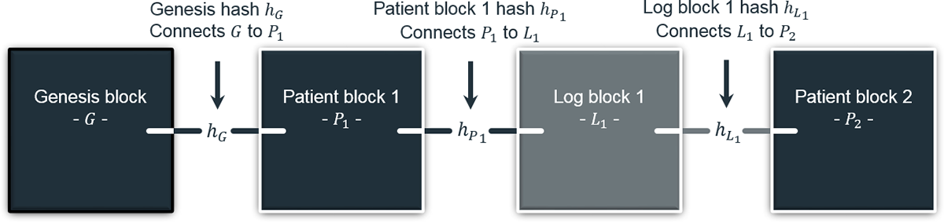
HealthChain
EHR exchange protocol desired for interoperability
Built around HL7 FHIR standard
Mixed-block approach
Trustless “Log Blocks” store history of data transfers (transactions)
Permissioned “Patient Blocks” handles access control of patient’s data
Proxy Re-Encryption (RPE) enables mutability – compliance with regulations
Notes:
R. H. Hylock and X. Zeng, “A Blockchain Framework for Patient-Centered Health Records and Exchange (HealthChain): Evaluation and Proof-of-Concept Study,” J Med Internet Res, vol. 21, no. 8, p. e13592, Aug. 2019, doi: 10.2196/13592.

Slide 10
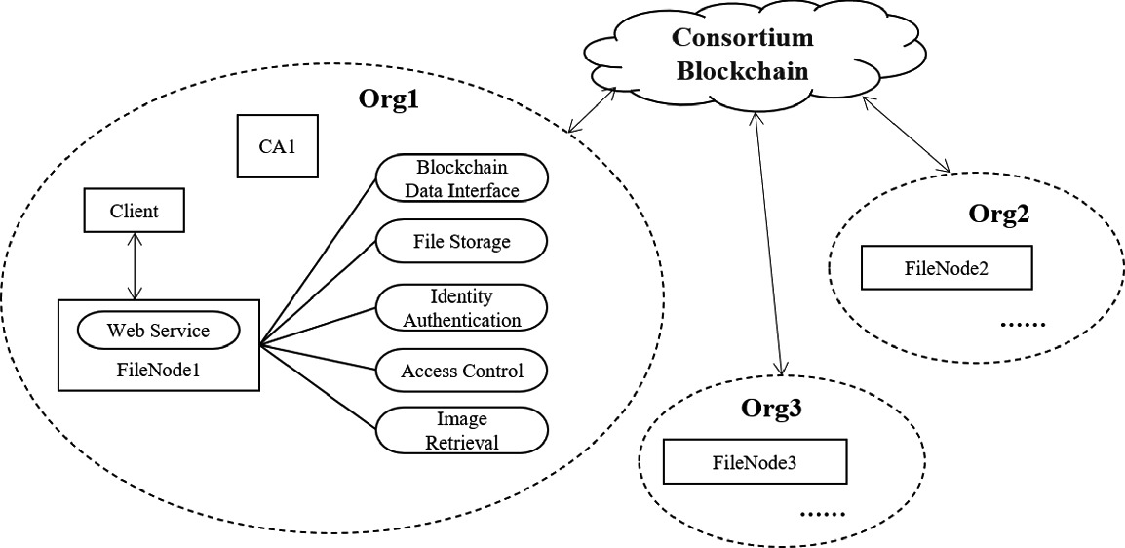
Medical Image File Sharing (MIFS)
Built around organizational-level FileNode’s
Each hospital operates their own node
Consortium blockchain handles data transactions
System built for sharing medical images for machine learning
Current systems severely limit medical image data for research

Slide 11
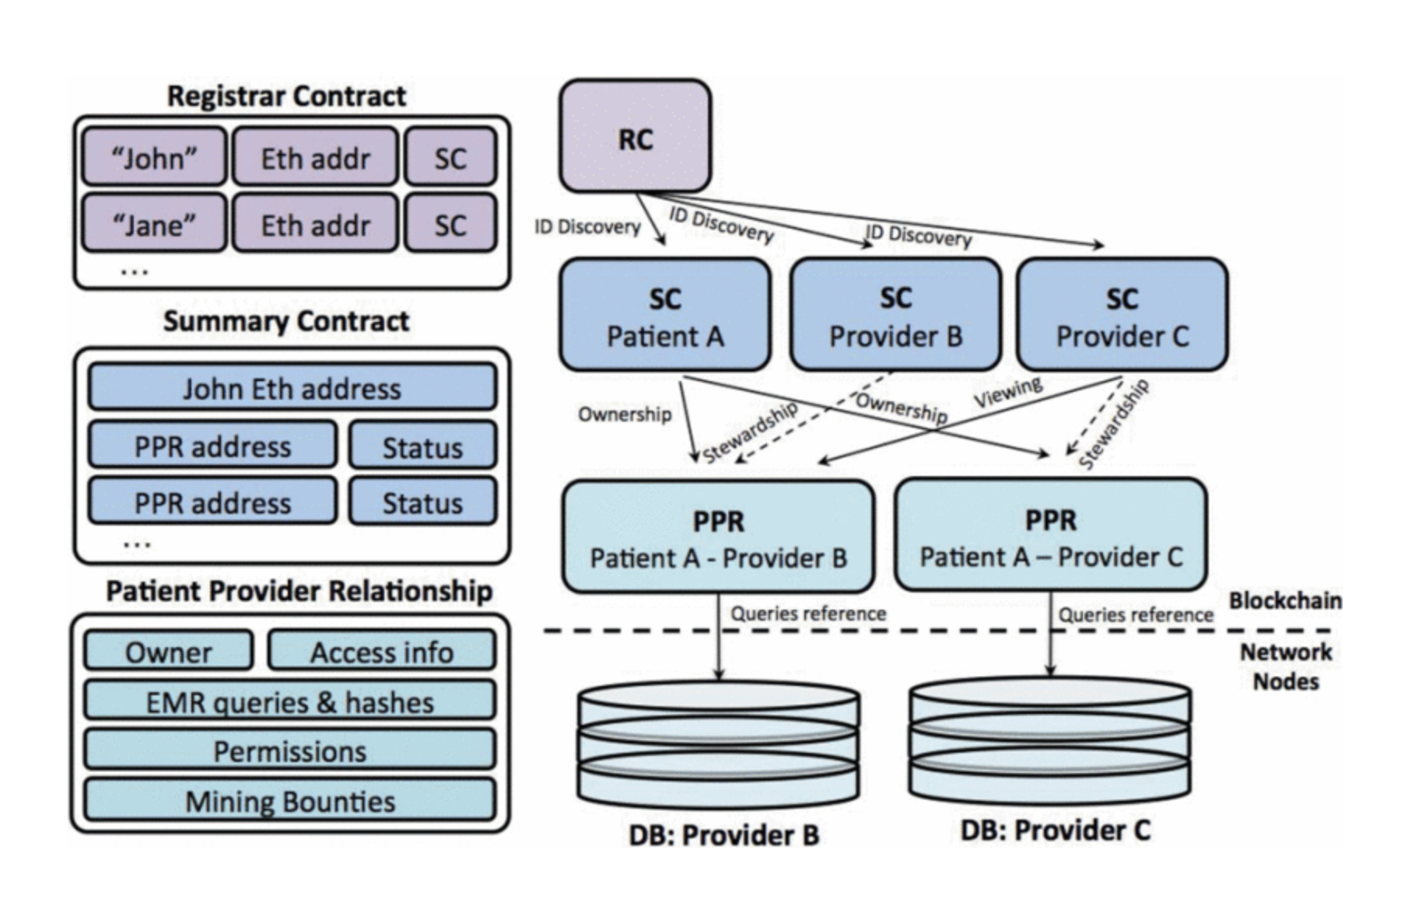
MedRec
MIT Media Lab project – uses smart contracts atop Ethereum Blockchain
3 contracts – Registrar, Summary, Patient-Provider
Registrar maps participants ID to their Ethereum wallet
Patient-provider relationship (PPR) contracts link 2 nodes in system
One node stores & manages records for another
Summary holds reference list to PPR contracts

